Slide 1




A Popular Choice Among Chinese Families
Fei He Xing Fei Fan Zhuo Rui Milk Powder
Date ：2024.11.27

Slide 2

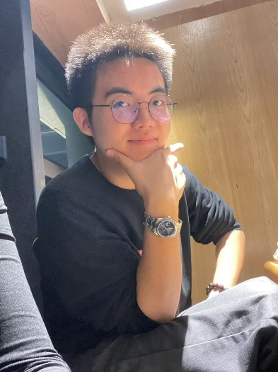
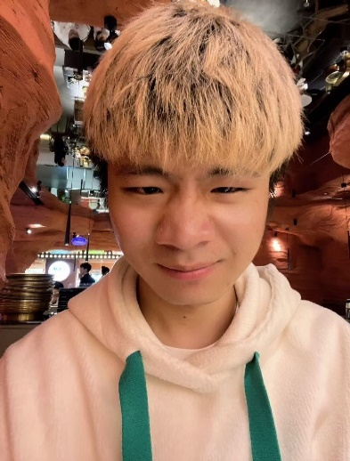
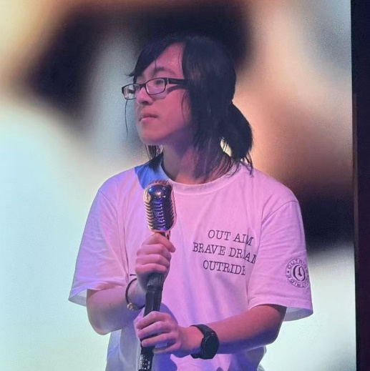
Group Members
Leader
2
3
柳开续 1210027423
千世儒 1210019411
秦钧天 1210020728
FMD BFNS Gemini ESFJ
Responsible for Questionnaire Design and Part 2:customer analysis
FMD BFNS
Constellation: Aquarius
Friendly and Patient
Responsible for The Collection of information and the production of the first slide of Part III.
FMD BFNS
Motto: Do one‘s best and follow God’s will
Hobbies: games, music, otaku
Outgoing, cheerful, and loves to make friends.
Hobbies： Play mobile games, Basketball, Tennis
Hobbies：K-pop, Movie, Foods
Responsible for Part 4 information, copywriting, PPT production.
Contributions:100%
Contributions:100%
Contributions:100%

Slide 3
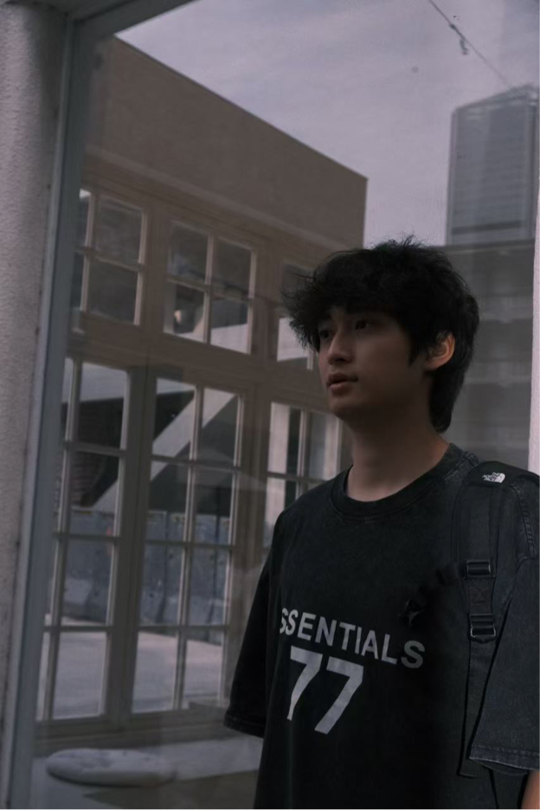
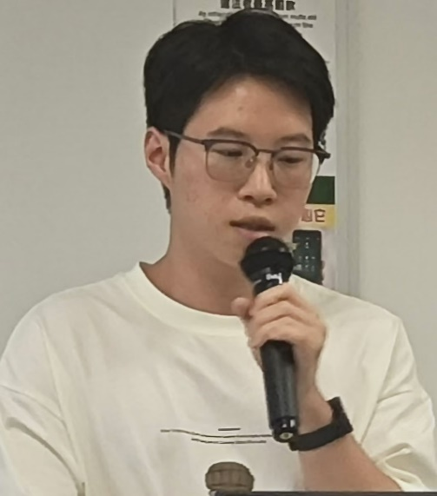
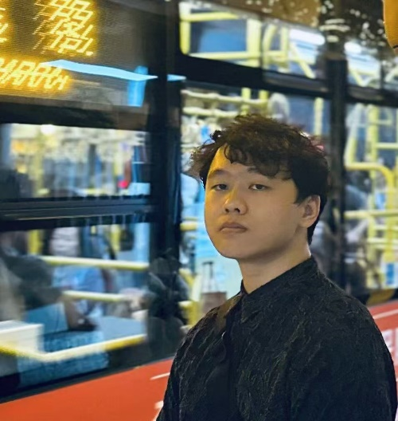
Group Members
4
5
6
李秉恒 1210030733
黃朝陽 1210007217
赵阳 1210018915
FMD BFNS
Forgetful and procrastinating
Lucky
Responsible for Part 1:
Speaker
Reviewer
Translator
·ISTJ-T
·FMD BFNS
·Friendly and Patient.
·Motto: Try to be Batter!
Responsible for Part 3:
Speaker
Translator
PPT Organization and Revision
Responsible for Part 4
·INTJ-A
·FMD BNFS
·Patient（adj.）
·Speaker
·Reviewer
·Translator
Hobbies: Console Games Watch Films
Hobbies:Music(Joker Xue), NBA
Games
Hobbies：Console Game，
NBA，F1，Cocktail
Contributions:100%
Contributions:100%
Contributions:100%

Slide 4

Contents
Part 1
Part 2
Part3
Part 4
Product Introduction
Customer Data Analysis
Market Positioning
Distribution Channel

Slide 5
PART 1
Product Introduction
Speaker： 李秉恆

Slide 6
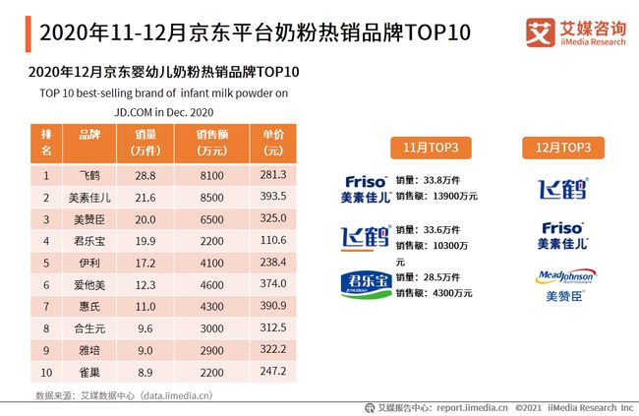

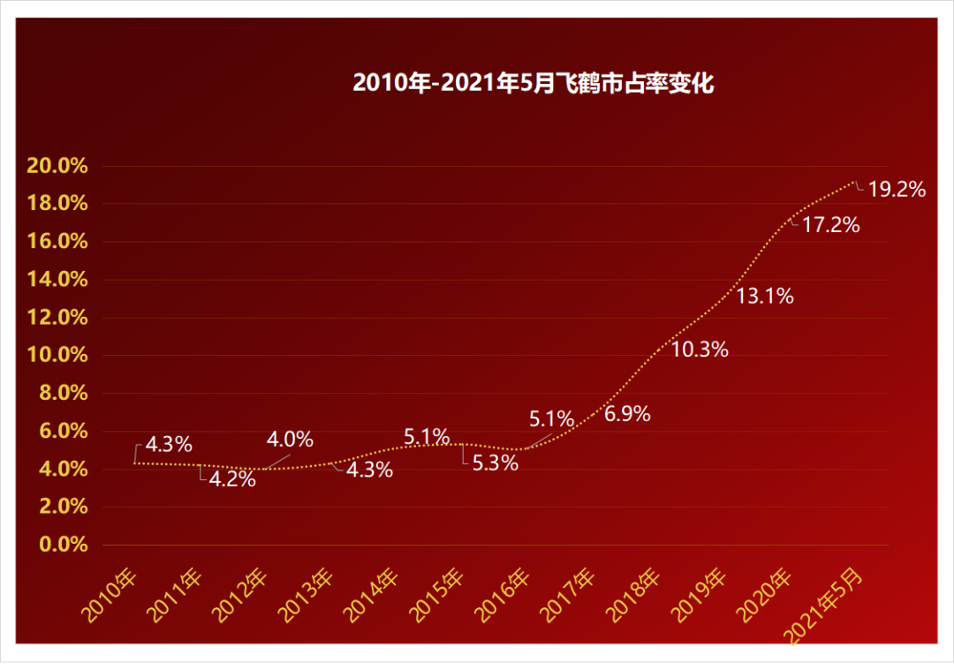
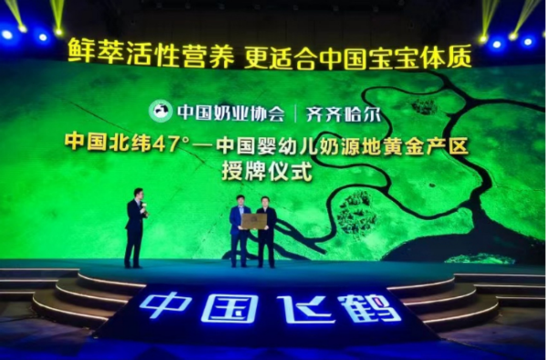

Branded products
飞鹤
星飞帆卓睿
Long History: founded in 1962
High Sales Volume: 21.5 per cent market share
Good Milk Source: 11, 12, 100,000, 1 million
Many innovations: more than 30 national and provincial scientific research projects
5 Features
4 Benefits

Slide 7
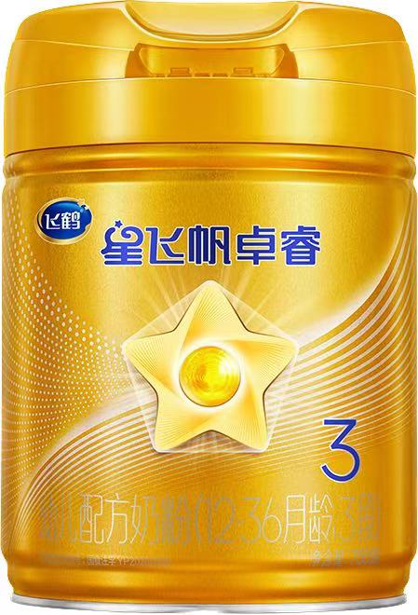
Product Characteristic
01
5 Features
鞘磷脂SM
卵磷脂PC
脑磷脂PE
磷脂酰肌醇PI
磷脂酰丝氨酸PS
Involved in myelin formation, providing nutritional security and promoting synthesis
02
4 Benefits
Nutrient-rich: Protein, vitamin A, calcium and other elements help to replenish nutrients, strengthen the body, promote growth and development, improve sleep quality and prevent constipation.
Good digestion and absorption: Hydrolysed small molecule protein and prebiotics formula helps digestion and absorption, preventing fire, and also contains lutein and lactoferrin to help strengthen immunity.
New formula: 100 times more probiotics to stimulate 290% immunoglobulin lg.
Various oligogalactans: promote the development of the immune system, synergise with the development of the flora, maintain the integrity of the intestinal barrier and the development of the brain.

Slide 8
Reason For Choice
Living needs: necessities in a family with a baby.
01
The market performed well: 5 months after its launch, the monthly sales exceeded 100 million, and in September 2023, it jumped to the first major product of offline "ultra-high-end +".
02
Able to grasp consumer psychology: Feihe is a product developed for children's brain development
03
04
Good feedback from team members after use: After half a month of use, no adverse effects were found, and the members at home used it well

Slide 9
PART 2
Customer Data Analysis
Speaker： 柳開續

Slide 10
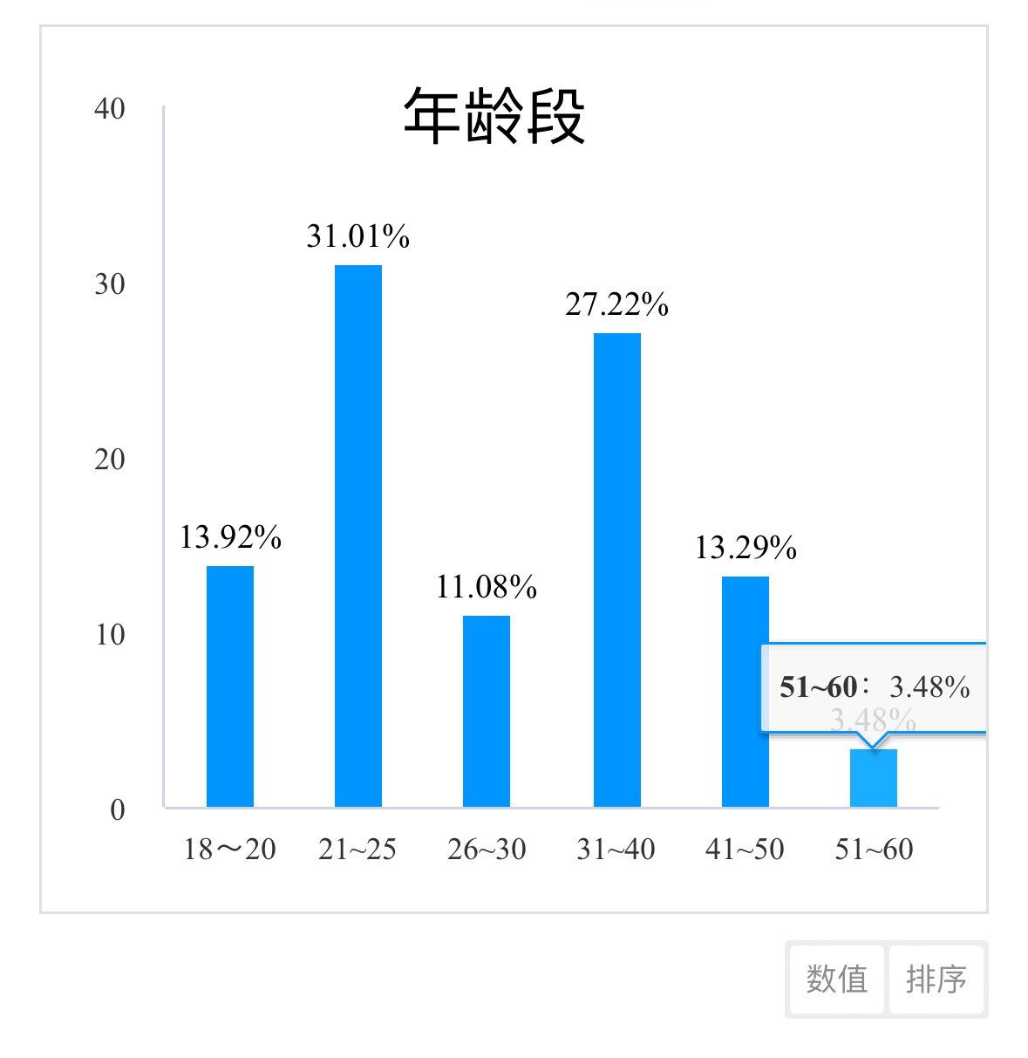
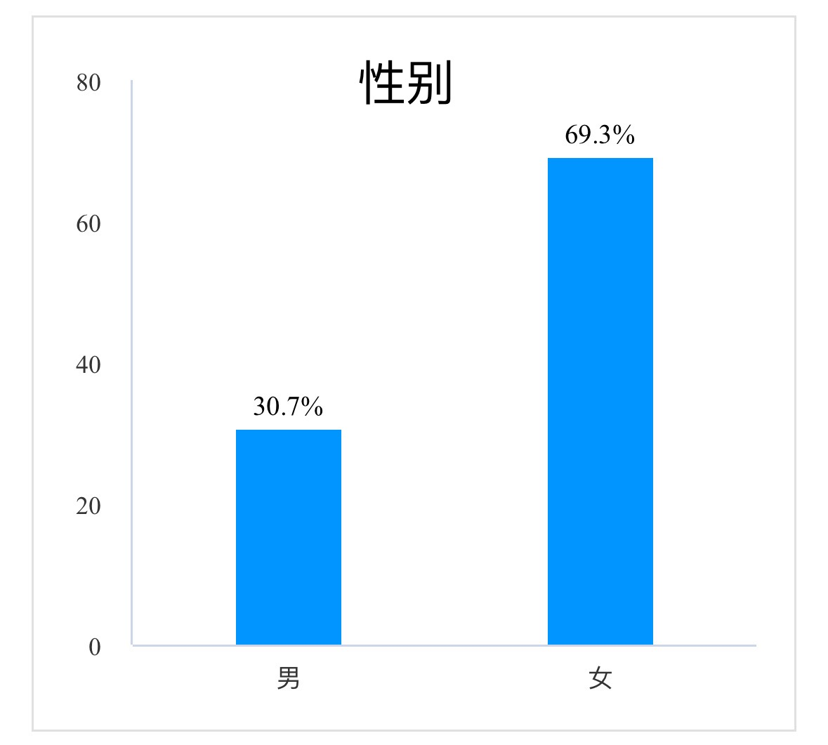
Customer Profile Analysis （total number of people：320）
1.The age Distribution of customers is roughly around 21-50 years old. 2. Mainly Female users.
03

Slide 11
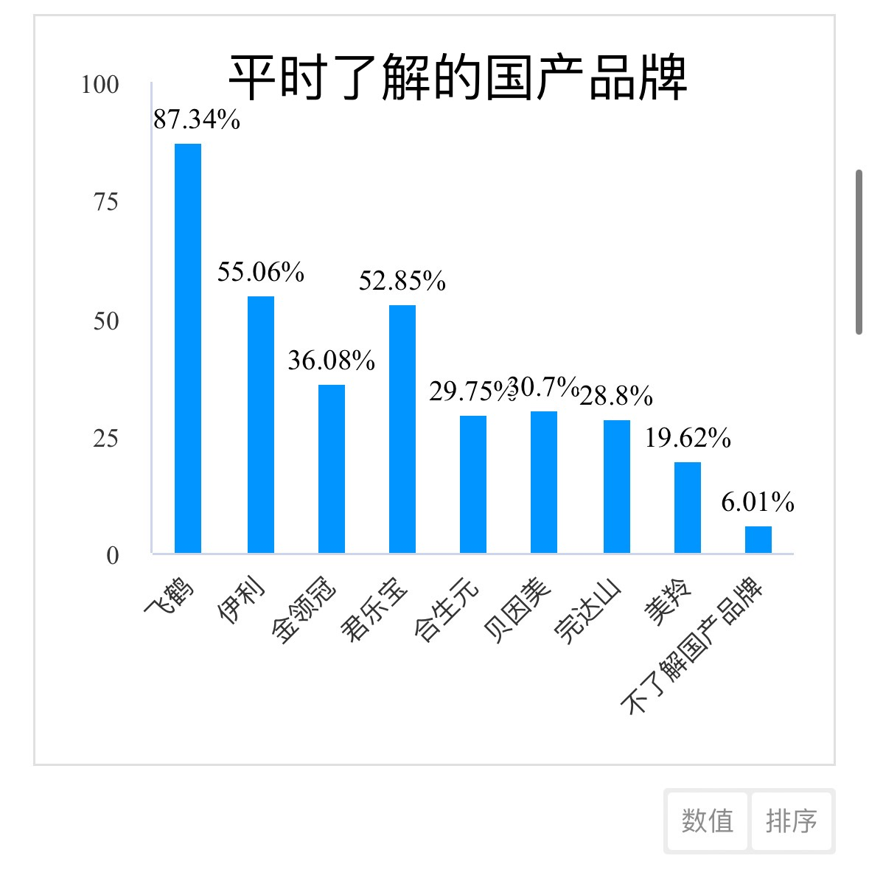
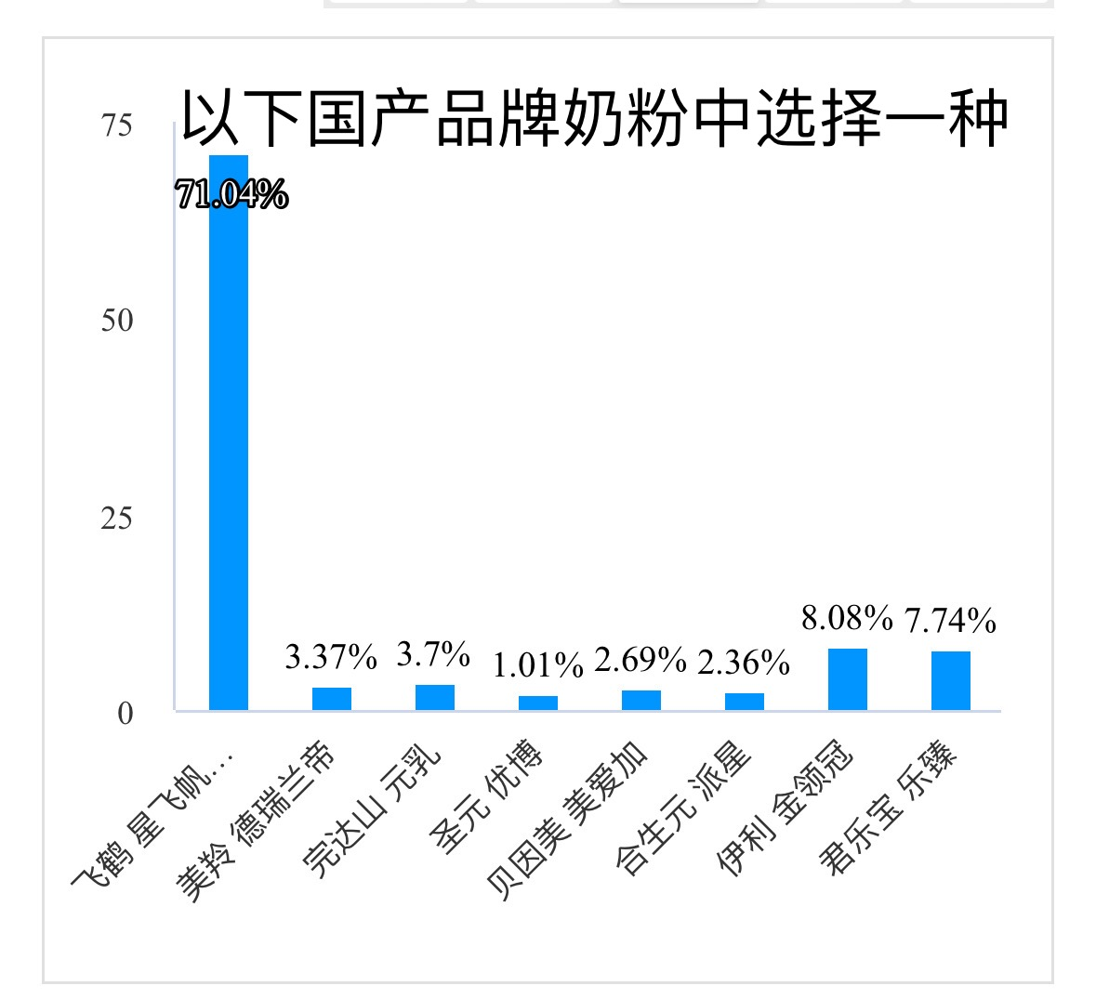
3. Purchase Preference: Among the similar competing products in different brands, Feihe's Xingfeifan Zhuorui is more popular with everyone; Everyone's understanding of Feihe's products is also higher than that of other competing products, reflecting Feihe's advantages of strong publicity and high product influence among mass consumers
03

Slide 12
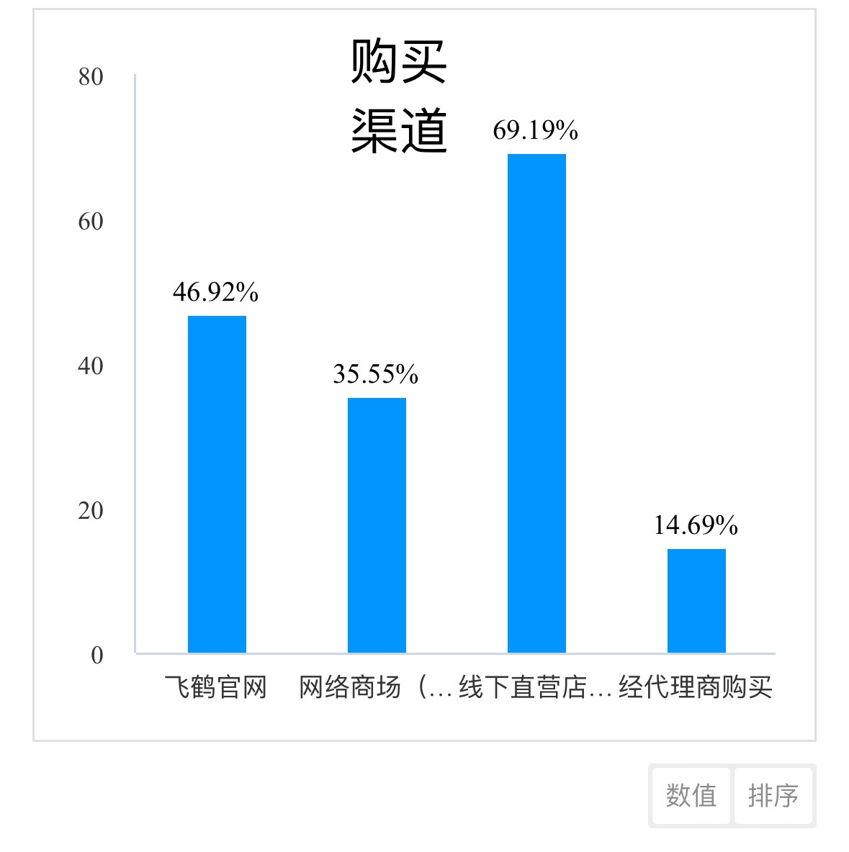
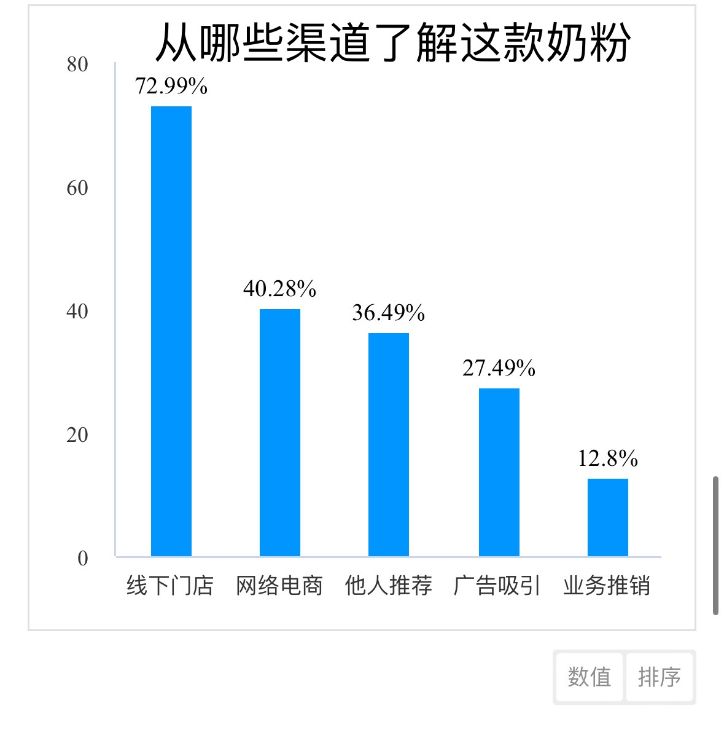
4. Purchase behavior: mainly rely on offline direct stores (more believe in the quality assurance of offline store products); The number of people is mainly promoted through offline stores, which shows that Feihe's offline marketing methods are effective and direct
03

Slide 13
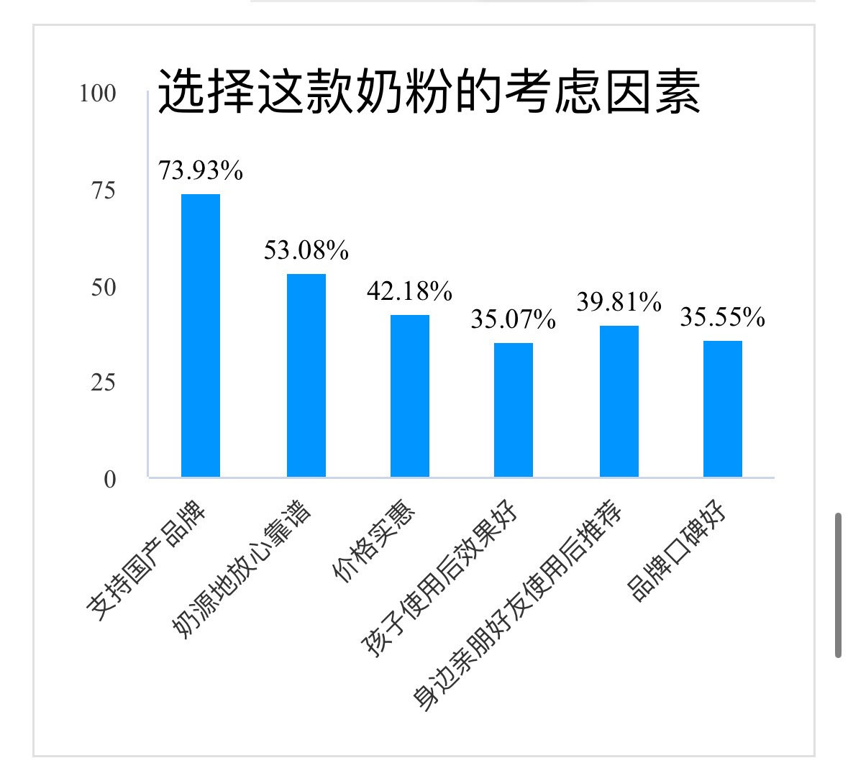
5. Satisfaction and Purchase Factors: most users will recommend the product after use, and the number of customer groups in the publicity among the public increases, forming a virtuous circle.
As a Domestic Brand of milk powder:
It can arouse patriotic feelings in the public psychology.
It has an independent high-quality milk source and processing plant, which promotes the development of the Feihe brand.
Its reasonable price can also increase the audience, and it is deeply loved by the Chinese people.
03

Slide 14
PART 3
Market Positioning
Speaker： 黃朝陽

Slide 15
Positioning Statement
01
02
03
Product Positioning
Target Audience
Customer Needs
High-end infant and children's milk powder products.
It is designed for young parents more concerned about a product's quality, reputation, and brand story.
It provides the nutritional needs of a healthy, well-digested, and well-absorbed diet.

Slide 16
Positioning Statement
04
05
Unique Selling Proposition
Reason for Purchase
The First Choice for Smart Babies.
The clinical feeding results were not significantly different from those of breastfeeding.
The company has its own domestic milk sources and research teams.

Slide 17
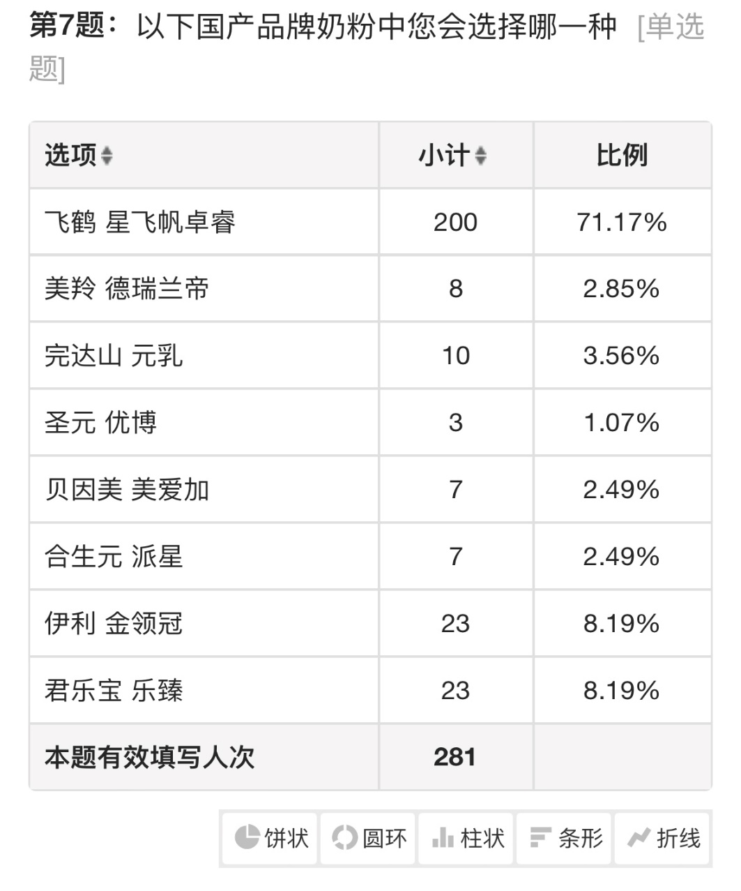
Differentiation
1.Price
Domestic Milk Powder Brand | Price
飞鹤 星非帆卓睿 | 238元750g
美羚 德瑞兰迪 | 300元800g
完达山 元乳 | 248元800g
圣元 优博 | 268元800g
贝因美 爱加 | 230元800g
合生元 派星 | 318元800g
伊利 金领冠 | 255元900g
君乐宝 乐臻 | 250元800g
The rice difference is not the main factor influencing parents' choice of domestic milk powder brands.
Product Features! Brand Value!

Slide 18
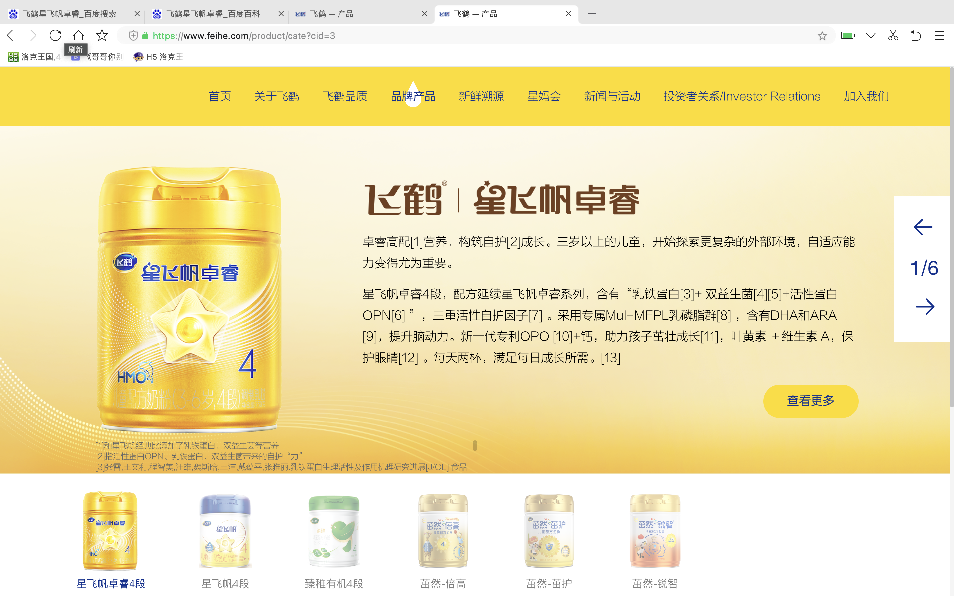
Differentiation
2.Product
The first infant formula product with brain-customized nutrients.
It caught parents' preferences for milk formula choices that focus on their Children’s Brain and Intellectual Development, becoming the choice of more parents for domestic milk formula.
Infant formula products from other brands pay more attention to the intestinal development of infants and young children and promote children's absorption of nutrients to meet the needs of children's brain development.

Slide 19
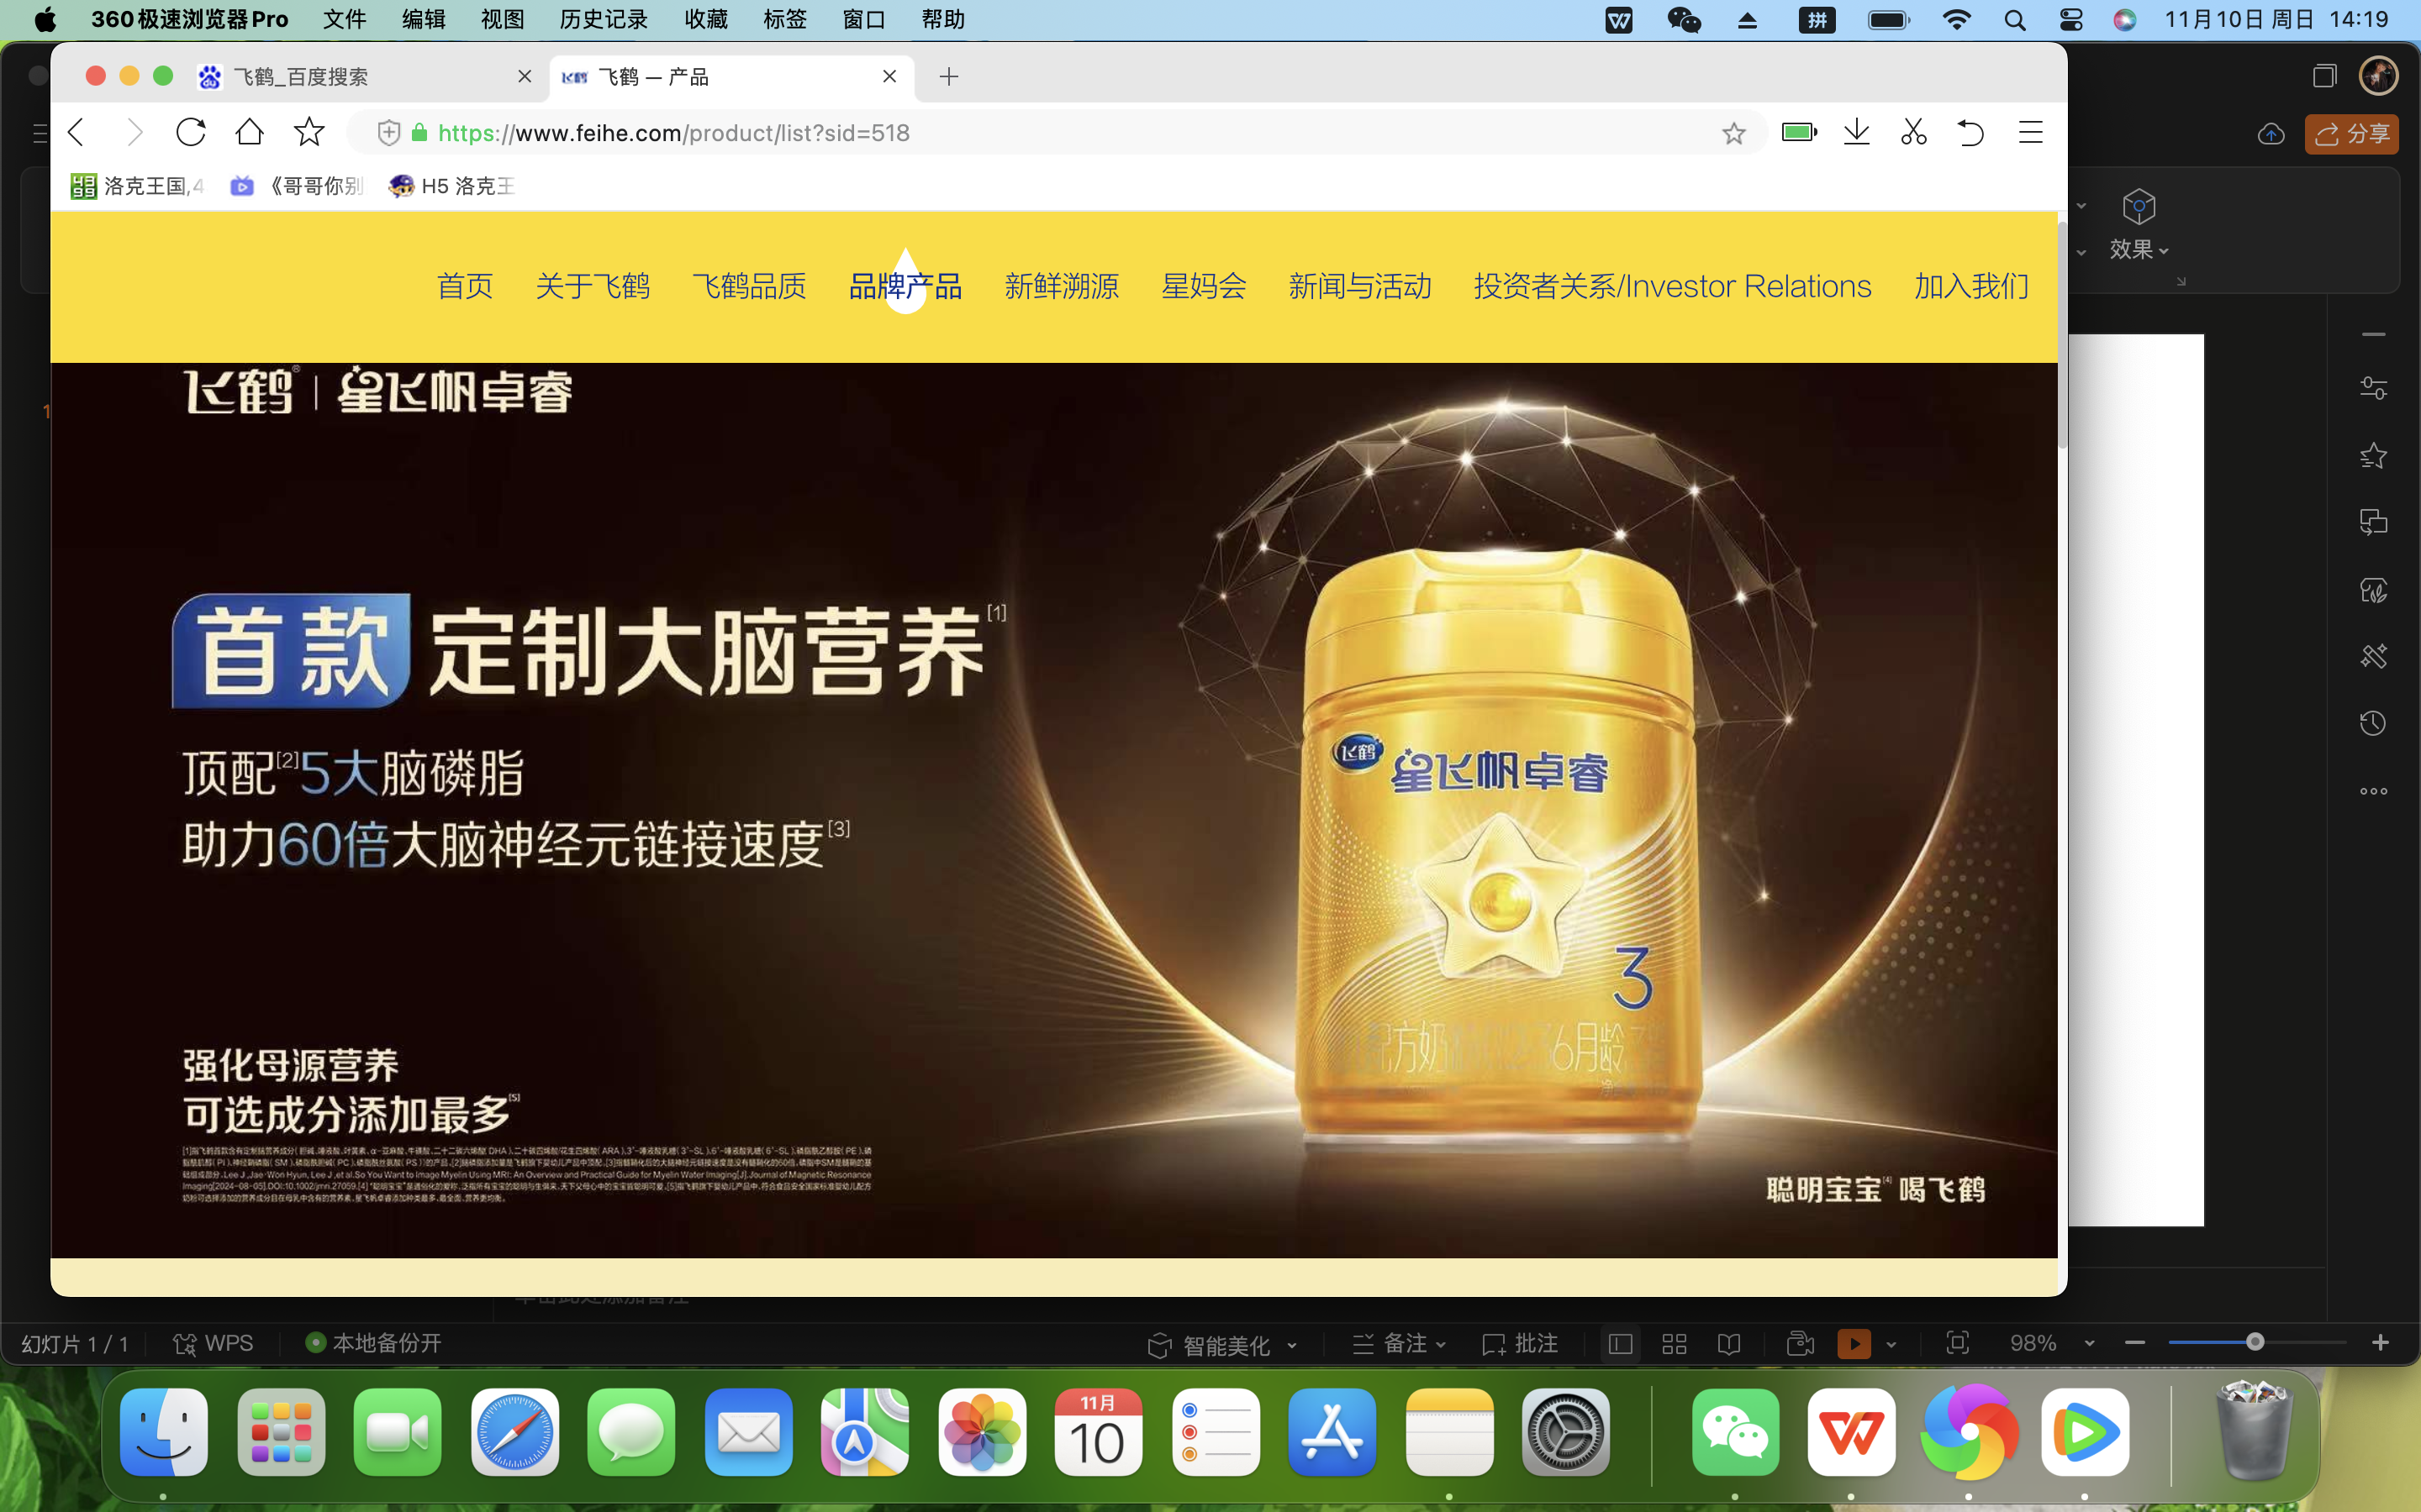
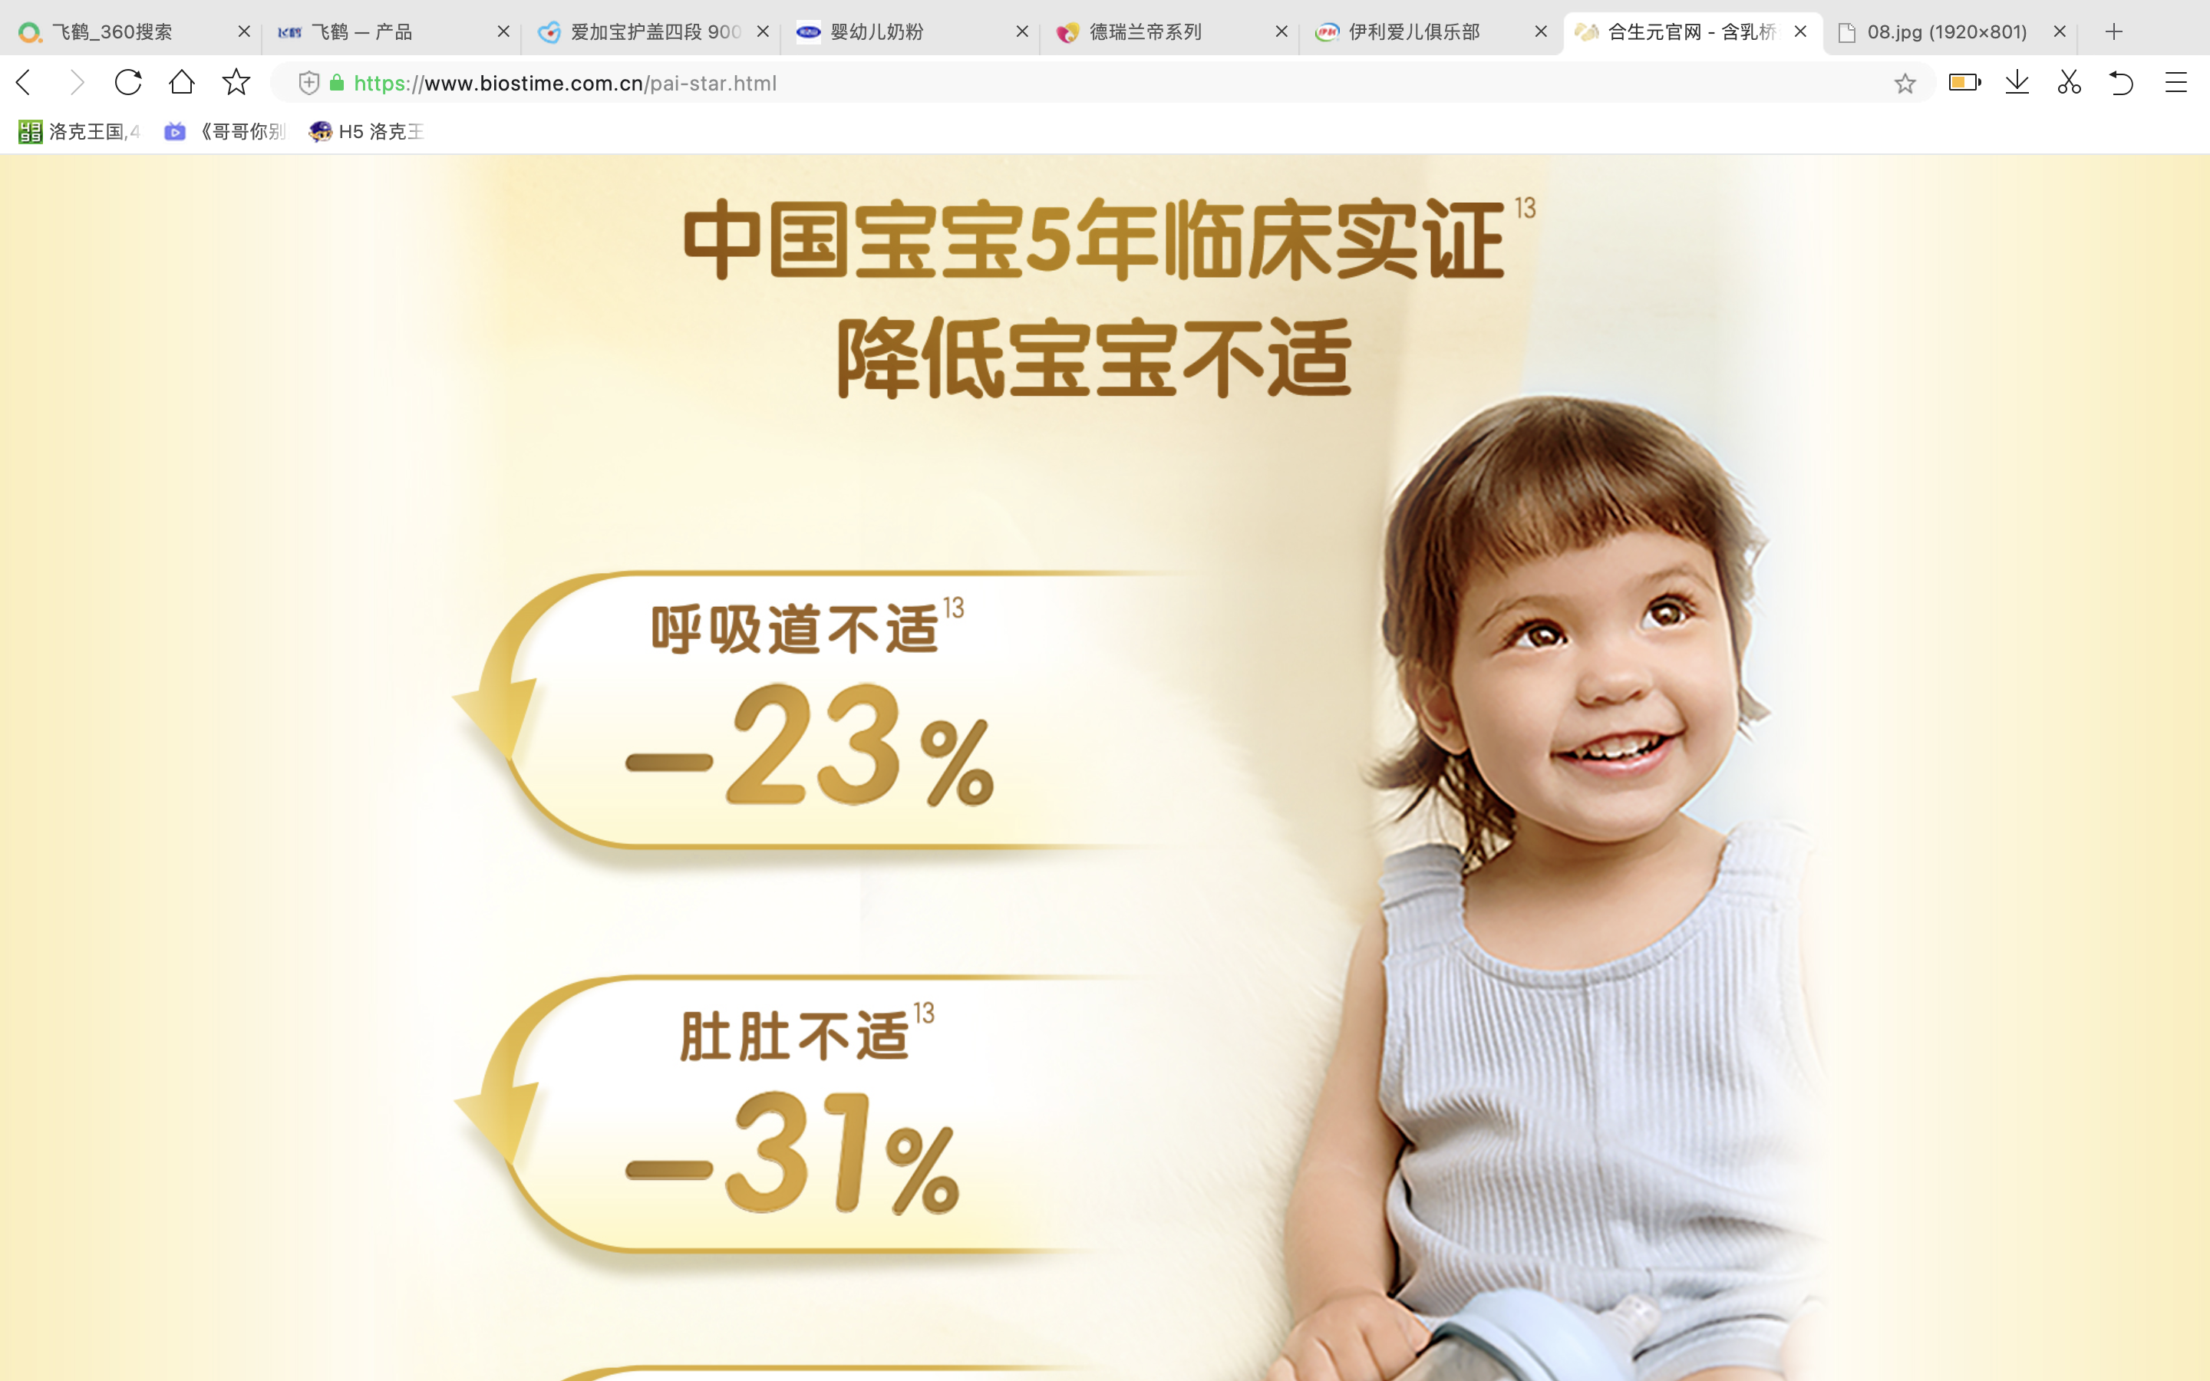
Differentiation
2.Product
The formula contains 15 active brain nutrients, and 100 times more probiotics have been added to enhance its effect on the Brain Development of infants and young children.
1
飞鹤星飞帆卓睿
It focuses on reducing gastrointestinal discomfort and protecting against the effects of intestinal development.
2
合生元派星

Slide 20
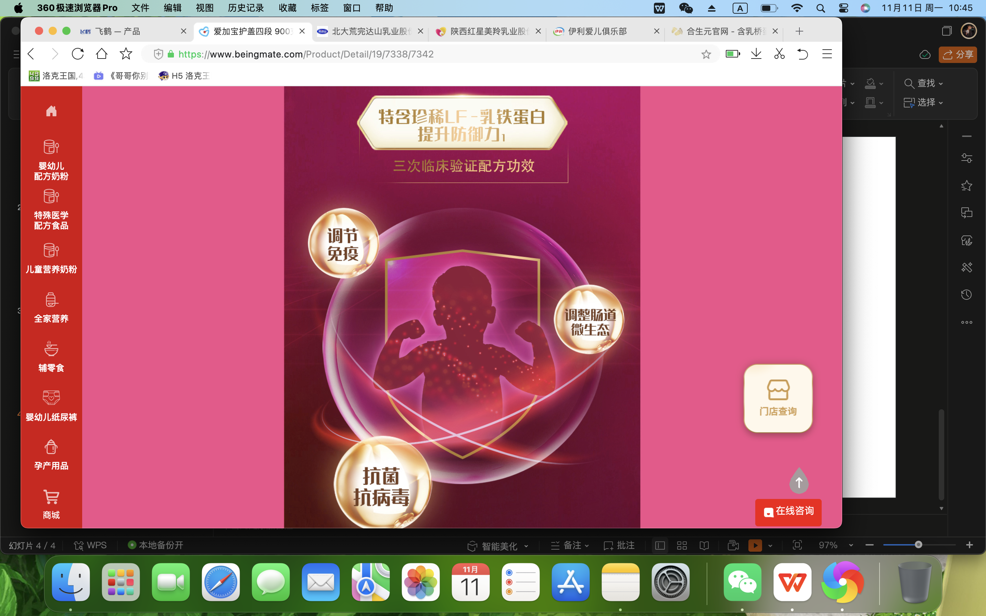
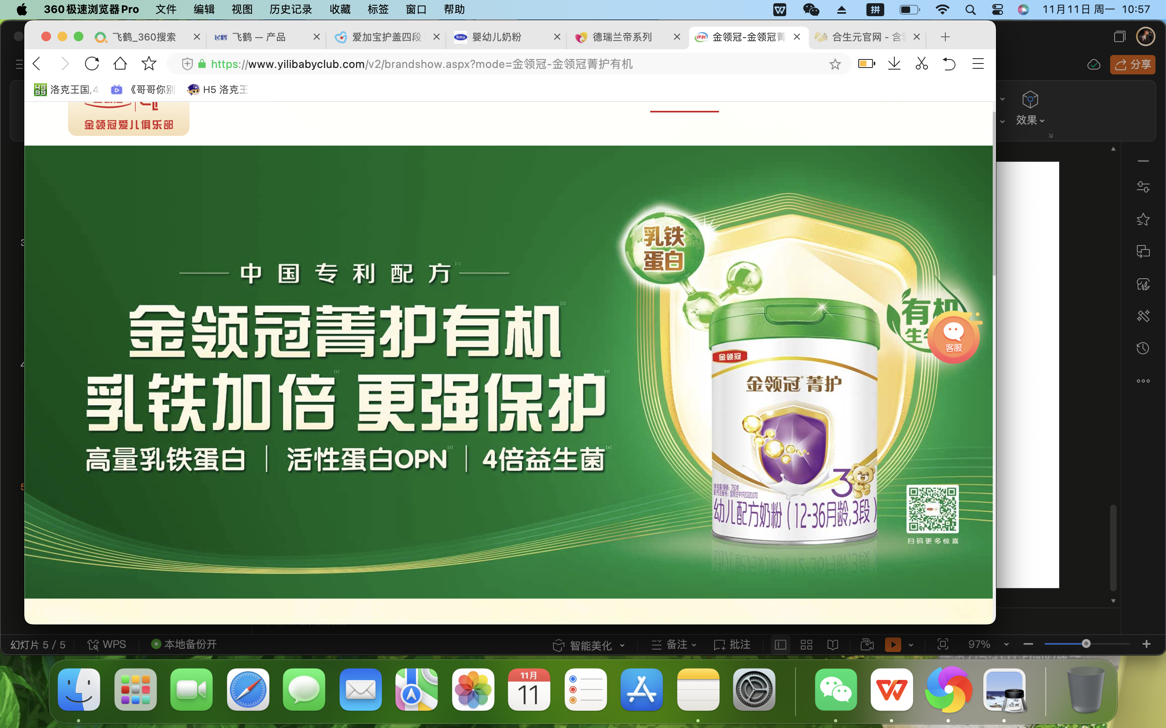
Differentiation
2.Product
It emphasizes the effect on the intestinal development of infants and young children.
3
贝因美爱加
Its products emphasize better absorption and promote intestinal development.
4
伊利金领冠

Slide 21
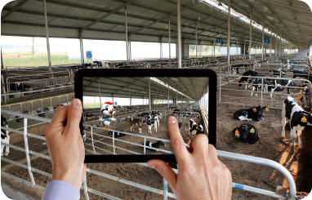
Differentiation
2.Service
Visible Farm
Consumers can use remote cameras installed at various links in the industrial chain to witness how Fei He milk powder is made anytime, anywhere on their personal computers or mobile phones.

Slide 22
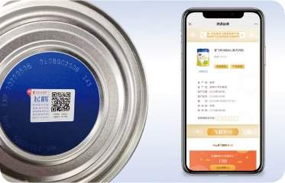
Differentiation
2.Service
Product Traceability System
In 2012, Fei He milk powder product traceability system was officially launched, making it one of the first infant milk powder companies in China to have a traceability system.
Consumers can not only check basic information such as the place of origin but also earn points and enjoy exclusive customized discounts and services.

Slide 23
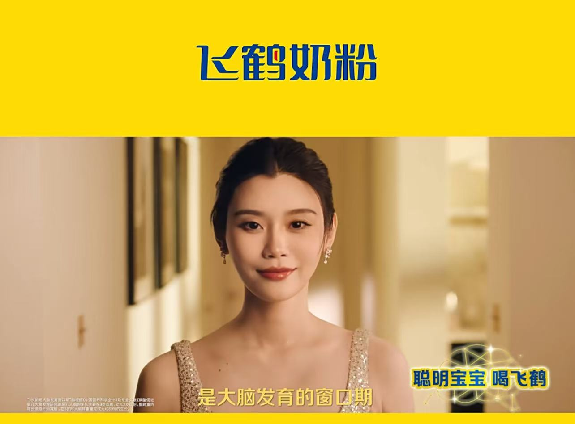
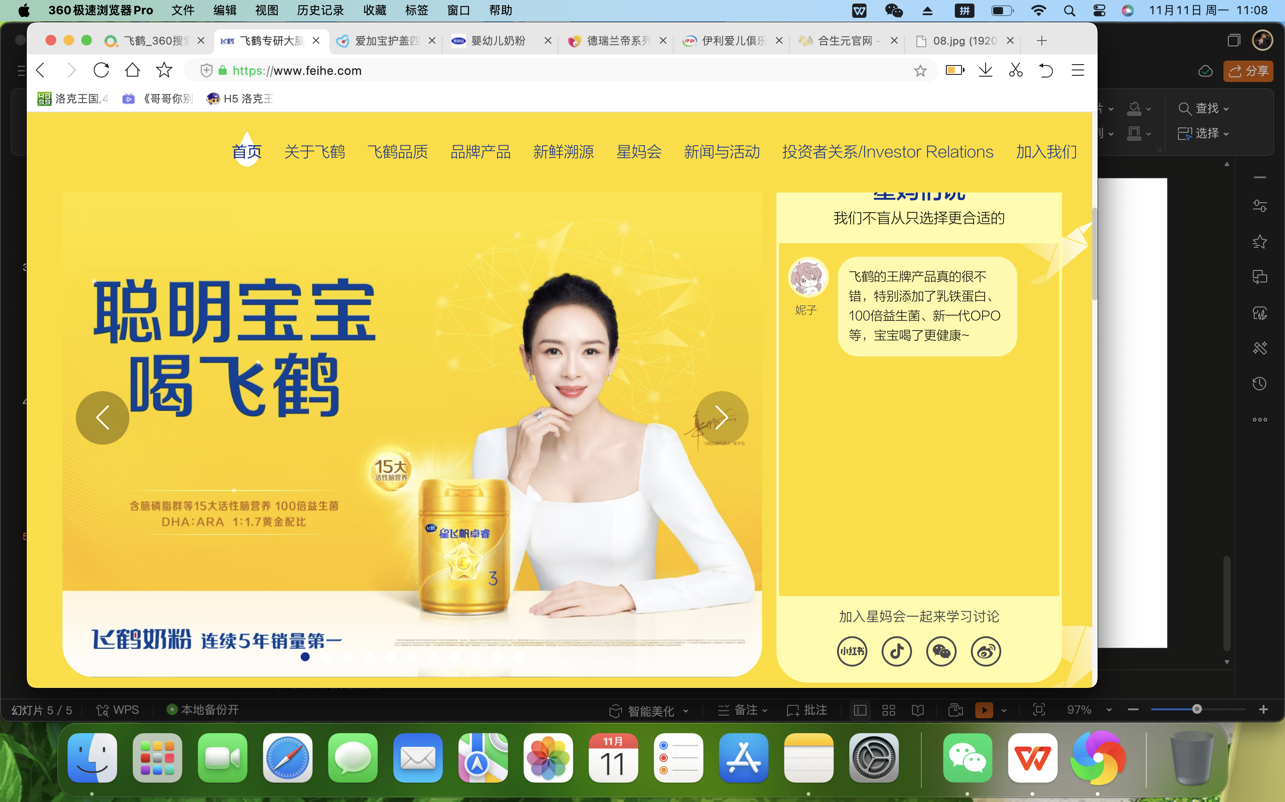
Differentiation
3. Promotion
Creating a Star Product:
The choice of is more in line with the age group of mainstream parents.
小标题
For example:
Supermodel Xi Mengyao.
Actress Zhang Ziyi.
小标题
More popular among consumers born in the post-90s and post-00s parent demographic
小标题
小标题
More popular among consumers born in the post-80s parent demographic

Slide 24
PART 4
Distribution Channel
Speaker： 趙陽

Slide 25
CONTENTS
01
02
03
04
Offline Distribution model
Offline Activity
Online synchronized publicity
Channel Analysis

Slide 26



1. Offline Distribution Model
Sales channels: offline distribution model
1. Offline Activity
2. Online synchronized publicity
Brand Side
Distributor
Retailers
Consumer

Slide 27
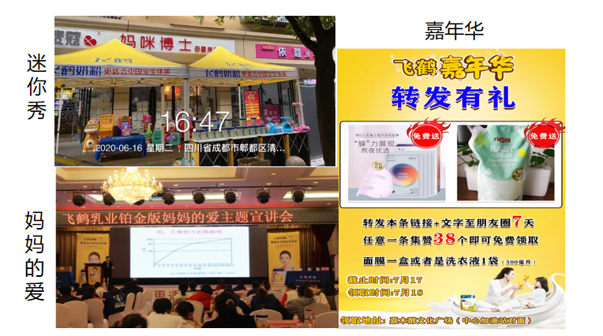
2. Offline Activity
Off-line activities are categorized into three types:
1. Mini-shows are mainly held in mom-and-pop stores, targeting parent-child families aged 0-5 years old;
2. Public Welfare Lectures are concentrated in hospitals and hotels;
3. Carnivals are targeted at the clientele of large shopping malls and shopping plazas
Among them, the mini-show activities accounted for more than 80%, the public welfare lecture activities were second, and the carnival was the least.
Purpose:
To convert participants into effective users
as well as long-term customers.

Slide 28
2. Offline Activity
Type of activity | Number | Scale of activities (number of persons) | Average cost input（RMB） | Sales output（RMB）
Mini Show | 80% of annual activities | 15-20 | 400 | 4000-10000
Mega-event | / | 100-200 | 3000-8000 | 33-35k
Carnival | 30 sessions/Y | 1000+ | 20-30k | 300k+
Public Lecture (small scale) | 20sessions+/Mo | 30-50 | / | 40% customer conversion rate
Public Lecture (large scale) | 6-7sessions/Mo | 100-200 | / | 40% customer conversion rate

Slide 29




2. Online Activity
Creating a unique IP: 5.28 China Baby Day
Branded Programs
Tiktok Live Streaming Sales

Slide 30
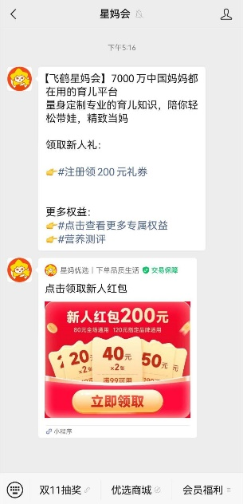
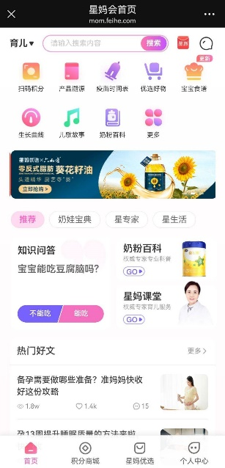
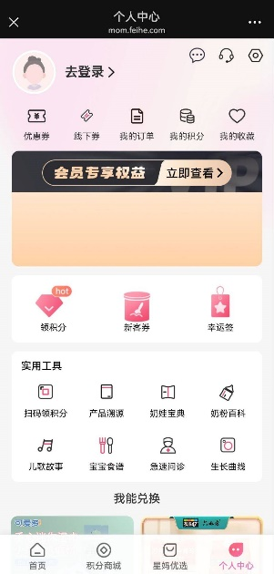
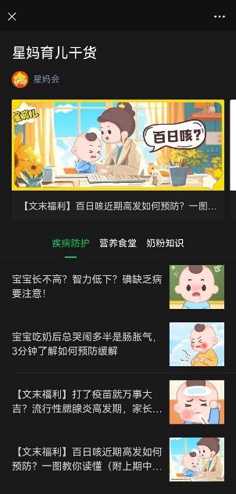
3. Online Synchronized Publicity
Creating the brand's exclusive public number builds a perfect membership system for Feihe, realizing customer retention as well as repurchase.
1 .Accurately determine the required products and services through user information tracking.
2 .Use cell phone numbers to link online and offline user purchase order data, aggregating information such as purchase records for the same account.
3. Offline activities to sweep the code record participation, online user behavior data records, the user's historical behavioral data and membership status matching unified summary to the membership system.

Slide 31
customer acquisition
activation
transaction
customer retention
Nutrition consultant, corporate microfinance
Offline event sales
Add Enterprise WeChat
Mom & Pop Shop Mini-Show
Official Public Account
Register as a member
Online
Public Lecture Program
Registration of mother and child information
Carnival Parent-Child Interaction
Media Platform Advertising
·QR code to check-in
·Giving gifts
Receive a newcomer's gift
Nutrition Consultant
Phone and SMS referrals
Purchase products to accumulate points
Community Activities
Sales during the epidemic
Redeeming Public Points for Gifts
Offline
Offline Event Invitation
WeChat, Community
Access to childcare knowledge and services

Slide 32
4. Channel Analysis
Advantage：
Provide actual product demonstration and trial, so that consumers can understand the product more intuitively.
Provide professional pre-sale and after-sale services to increase consumers' trust and loyalty to the products.
Face-to-face communication with consumers to understand consumer needs and feedback
Attract consumers through the location and brand image of the physical store to increase brand awareness and reputation.
Retained a relatively traditional sales model for those who are inconvenienced by the use of e-commerce platforms.

Slide 33
4. Channel Analysis
Disadvantage：
Requires significant capital investment up front
Higher labor costs .
Higher operating costs
Limited coverage and difficulty in realizing cross-regional sales.
Offline sales are difficult to monitor data in real time for accurate analysis and optimization.

Slide 34
Thank You For Watching!

